Slide 1
Lyra – reporting amendments

Slide 2
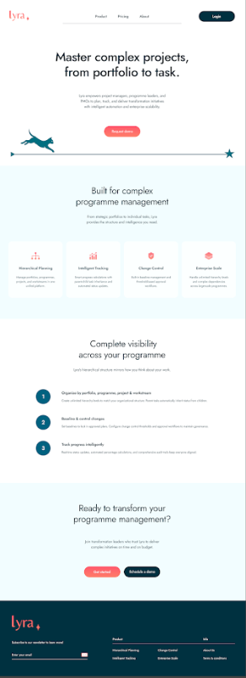
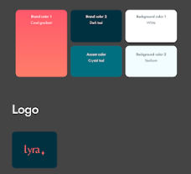
Create pre-prepared reports in the reports screen using the structure and fields on the following slides for workstream, project and steerco reporting.
Change the formatting to be consistent with the lyra formatting provided here
These are templates, the data will be populated by the data in the plan and customisable by the user
Add options on the report page for the user to select the project/workstream/steerco and date period for the data to be pulled

Slide 3
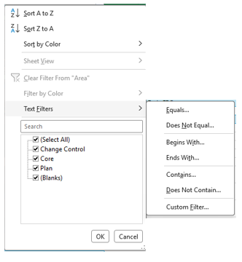
Report screen changes
2. List of all columns set up in plan appears. When user hovers on item, contents of column appears for user to select. If many items in list, user clicks on column name e.g project and then can search or type project name. can multi select
Gantt Filter
Select column
Programme
Programme 1
Project
Programme 2
1. User clicks on drop down and sees all columns set up in plan
Programme n
This is the equivalent of the list of all the columns

Slide 4
Workstream Reporting
Ownership
Workstream: #Workstream Owner: #Owner Workstream ID: #ID
Scope
#Scope
Executive Summary | RAG
#Summary
Key risks and issues
#Key risks
Key dependencies
#Key dependencies
Milestones completed this week
#Milestone | #Start-date | #End-date
Milestones missed
#Milestone | #Start-date | #End-date
Milestones due next week
#Milestone | #Start-date | #End-date
Upcoming milestones at risk
#Milestone | #Start-date | #End-date

Slide 5
Project / Programme Reporting (Aggregated)
Leadership
Name of Project/Programme: #Name Project/Programme ID: #ID Sponsor: #Sponsor Programme director: #Programme director
Scope
#Scope
Executive Summary | RAG
#Summary
Key risks and issues
#Key risks
Key dependencies
#Key dependencies
Milestones completed this week
#Milestone | #Start-date | #End-date
Milestones missed
#Milestone | #Start-date | #End-date
Milestones due next week
#Milestone | #Start-date | #End-date
Upcoming milestones at risk
#Milestone | #Start-date | #End-date

Slide 6
SteerCo Reporting (Aggregated)
Leadership
Portfolio/Programme name: #Name Portfolio/Programme ID: #ID Portfolio/Programme owner: #Owner
Scope
#Scope
Executive Summary | RAG
#Summary
Budget Summary
Budget | Spend YTD | Forecast | Variance to budget | Variance %
#Budget | #Date | #Forecast | #Variance | #VarPer
Remaining budget
42,6%
57,4%
Budget used so far
Resourcing Summary | RAG
#ResourcingSummary
Portfolio programme
Resources on the ground
17
Resources to be hired
Schedule Summary | RAG
#ScheduleSummary

